Slide 1


What makes a song popular?
Kruskal Wallis Test
Presented by: Aashna Gandhi (S052)
Kinjal Joshi (S057)
Keisha Sahni (S060)
Krisha Desai (S061)
Mentored by: Dr. Hemant Kulkarni

Slide 2
Overview
Introduction to the topic
Graphs
Project Objectives
Inference
Statistical Techniques
Conclusion
Project Timeline
Webliography
Methodology
Acknowledgement

Slide 3
Music is an essential part of the way we live. And because of this, we wanted to discover the patterns in the music that gets popular. One of the most popular streaming services is Spotify. Spotify is an audio streaming platform and it provides music to over 406 million monthly active users. We took the top 30 songs off the billboard-hot 100 list for each year from 2010 to 2019 and with the help of web API, we chose the attributes that match the song format. With the help of those attributes, we performed our analysis.
Introductionto the Topic

Slide 4
To find what attributes or features of a song are responsible for its popularity based on top charts.
Project
Objective

Slide 5

Correlation coefficient and correlation test
Heat Maps
Statistical
Techniques
Shapiro Wilk Test
Kruskal Wallis Test
Wilcoxon Rank Sum Test

Slide 6
Pearson & Spearman Correlation
Coefficient
Measures the linear correlation between two datasets
If the value is exactly -1 or +1 it means that the data points lie exactly on the line.

Slide 7
Graphical representation of data that uses a system of colour-coding to represent different values
Heat
Maps
Used in various forms of analytics but are most commonly used to show user behaviour.
Useful for comparing elements that are given similar prominence on the page.

Slide 8
The Shapiro–Wilk test tests the null hypothesis that a sample x1, ..., xn came from a normally distributed population.
If the p-value is less than the chosen alpha level, then the null hypothesis is rejected.
Shapiro Wilk Test
This test is used when The data do not meet the requirements for a parametric test.
Here our hypothesis would be:
Null hypothesis: The k distributions are identical.
Alternative hypothesis: At least one distribution is different.
Kruskal Wallis
Test

Slide 9
The Wilcoxon rank-sum test is a nonparametric alternative to the two sample t-test which is based solely on the order in which the observations from the two samples fall.
Wilcoxon Rank Sum Test
Here our hypothesis would be:
Null hypothesis: The population medians are equal.
Alternative hypothesis: The population medians are not equal.

Slide 10
Project Timeline
Kruskal Wallis
test and Wilcoxon Sum Rank Test
Deriving conclusions from the analysis
Data collection
Preparing the dataset
Shapiro Wilk test
Setting the objective
Data Wrangling
Normality test using QQ plot
Correlation Coefficient tests and heat map
Interpretation of data

Slide 11
Data collection: The data for our project was collected from the billboard yearly top 100 charts and the Spotify API.
Data Wrangling and Preparation of our dataset: In this step, we limited the top 100 songs of each year (from 2010 to 2019) to a total of 30 top songs from each year. After obtaining the 30 top songs, we requested details of each track from the spotify API using Python.
Methodology

Slide 12
Our dataset consists of 15 variables,
Rank (Top 30)
Title
Artist
Top Genre
Year (2010 to 2019)
BPM (0 to 206)
Energy (0 to 100)
Danceability (0 to 100)
Loudness (-11 dB to -2 dB)
Liveness (0 to 100)
Valence (0 to 100)
Duration (134 to 424)
Acousticness (0 to 100)
Speechiness (0 to 100)
Popularity (0 to 100)
Summary of the Dataset

Slide 13
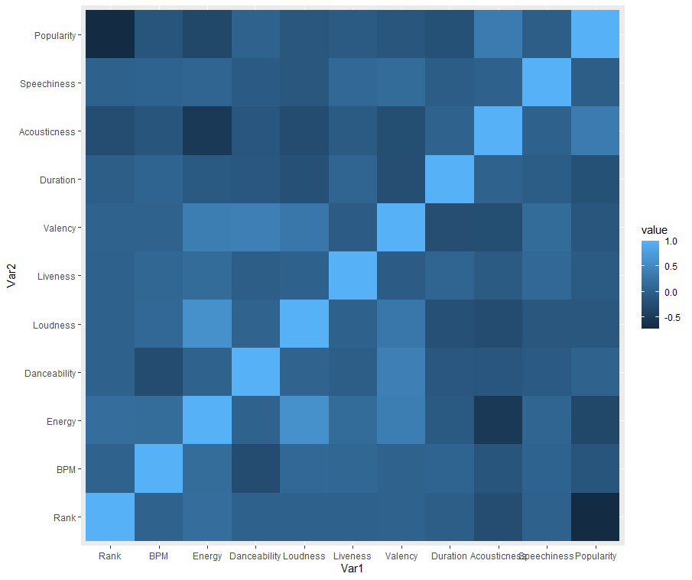
Heat Map
This heat map uses the values of Pearson and Spearman's correlation tests.
The lighter the gradient of the block, the higher the correlation of the two variables.

Slide 14
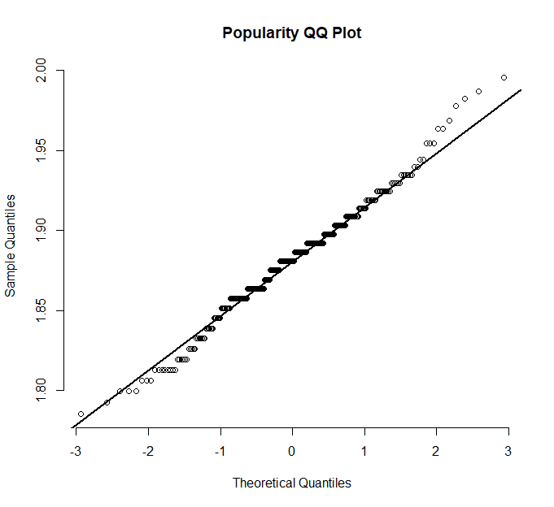
Normality test using QQ Plots
This is the QQ Plot for Popularity.
The greater the departure from the reference line, the greater the evidence for the conclusion that the dataset does not follow normal distribution.
By looking at the graph we can come to a conclusion that since the points form a curve that deviates markedly from the straight line, our data may not be normal.

Slide 15
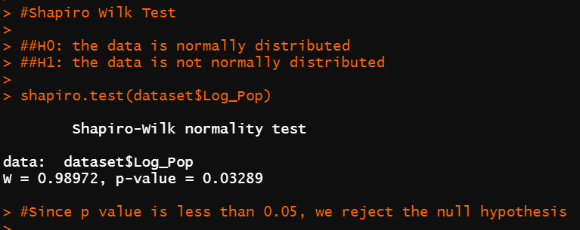
Shapiro Wilk Test
Since the p-value < 0.05, we reject our null hypothesis which was that the data is normally distributed, and accept the alternate hypothesis and conclude that there is a deviation from normality.

Slide 16
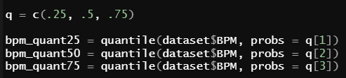
We find the quartiles for the variables as follows:
Categorising the associated variables
We make 4 categories for all variables,
0% to 25% - Very Low
25% to 50% - Low
50% to 75% - High
75% to 100% - Very High

Slide 17
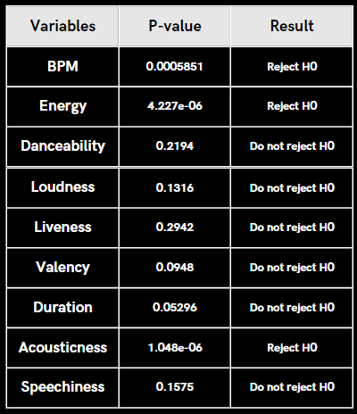
Kruskal Wallis Test
H0: The medians are identical.
H1: At least one pair of medians is different.

Slide 18
H01: BPM has no effect on the Popularity of a song.
H11: The higher the BPM, the higher the Popularity of a song.
H02: Energy has no effect on the Popularity of a song.
H12: The higher the Energy, the higher the Popularity of a song.
H03: Acousticness has no effect on the Popularity of a song.
H13: The lower the acousticness, the higher the Popularity of a song.
Formation of the hypotheses
Based on previous work done in this domain, we can form several alternative hypotheses for the wilcoxon rank sum test, to test the relation of bpm, energy and acousticness with popularity.

Slide 19
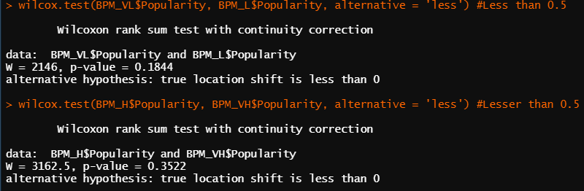
We perform the Wilcoxon Rank Sum Test for all consecutive categories of the variables that rejected H0 in the Kruskal Wallis Test.
The categories of each variable are:
Very Low
Low
High
Very High
Wilcoxon Rank-Sum Test

Slide 20
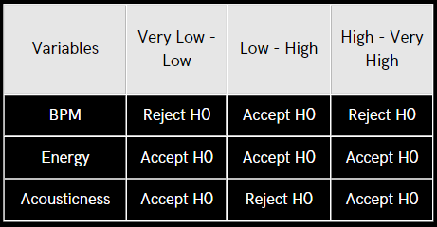
We perform left tailed tests for BPM and Energy and right tailed tests for Acousticness.
Wilcoxon Rank-Sum Test

Slide 21
Popularity is positively affected by BPM.
A score of acousticness below 2 and above 17 is an ideal range for higher popularity.
Conclusion

Slide 22
Which Musical Tempos are People Streaming the Most?
Pop Hits Were Really Slow (Again) in 2018
Webliography
Musical Attributes
Popularity, Mood, Energy, and Typicality in Music: A Computerized Analysis of 204,506 Pieces

Slide 23
Acknowledgement
Appreciation, inspiration and motivation have always played a key role in the success of any project.
We feel to acknowledge our indebtedness to our professor, Dr. Hemant Kulkarni whose valuable guidance and supervision helped us throughout and shaped the present work in its show.
We would also like to thank everyone else who have directly or indirectly been a part of making our presentation a successful one.

Slide 24




Thank You!
AASHNA GANDHI
KEISHA SAHNI
KINJAL JOSHI
KRISHA DESAI
75252019091
75252019134
75252019111
75252019135

